Slide 1
Melbourne HOUSING 2016-2017

Slide 2
Agenda
The project
Insights of the market
Conclusions
Learnings &Further Analysis

Slide 3
Melbourne real state market
1
2
3
Real estate market in Melbourne is crucial for both sellers and buyers, as it allows them to make informed decisions regarding area selection, choosing a real estate agent, type of property, market timing and reviewing prices trends
Using Kaggle data for +13K transactions of Melbourne Housing Market find out what influences the purchases and prices, is it location?, type?, numbers of Rooms?
What are the best recommendations we can provide to buyers and sellers according to drivers of prices in Melbourne housing

Slide 4

How Has the market performed

Slide 6
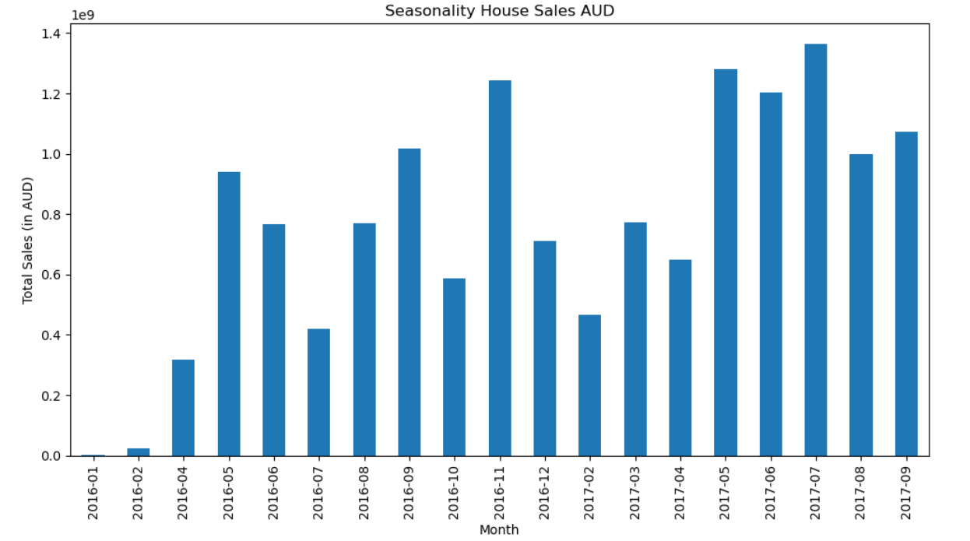
TOTAL Seasonality/trends of salES
We can observe 2 trends:
2017 sales have been higher than 2016 in total
first half of the year have lower sales so if you are a buyer you probably want to check this time of the year for a lower demand
Second half of the year is the most active time to move real estate in Melbourne

Slide 7
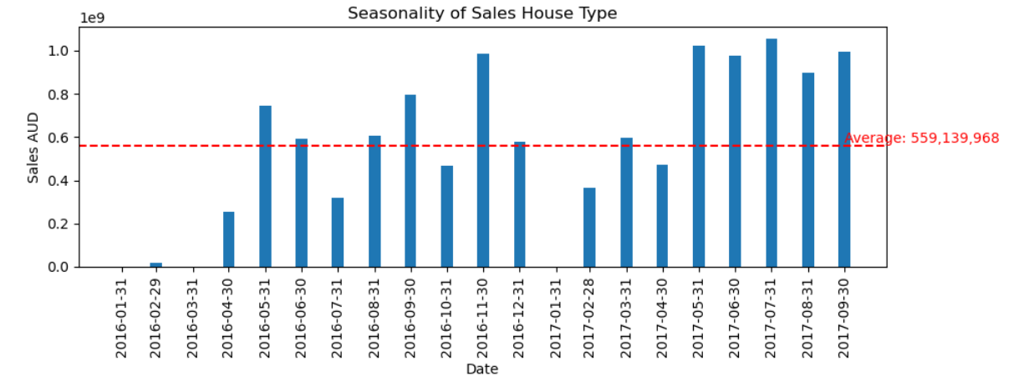
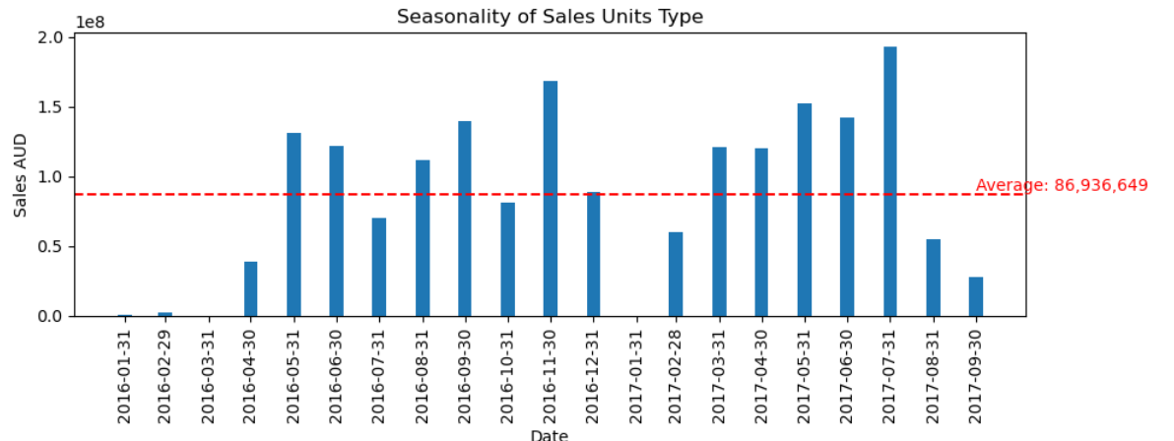
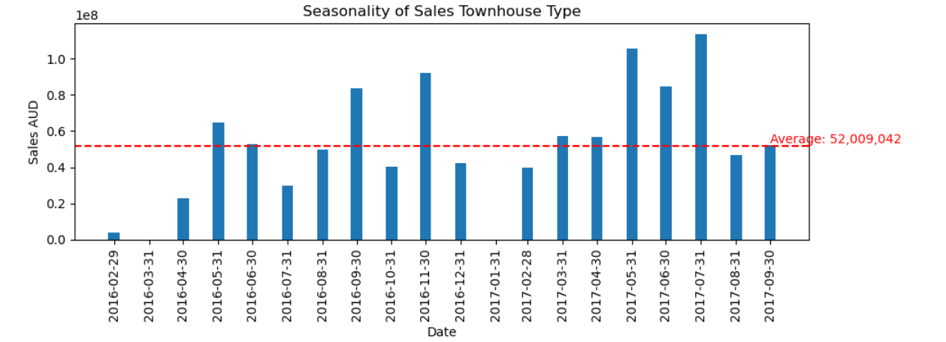
Seasonality/Trends of sales per TYpe
We observed:
Average sales for Houses are the highest its 10x Townhouses and 6x Units
Houses trend is higher for the second half of the year
Both Units and Townhouses sales have drop in the last 2 months

Slide 8
Prices trends

Slide 9
Sales Mix

Slide 10
Sales Mix

Slide 11
Correlations

Slide 12

Conclusions

Slide 13
Recommendations for sellers and buyers

Slide 14
Learnings & Further Analysis

Slide 15
Effective delivery techniques
Learnings and Challenges
Further Analysis

